Slide 1
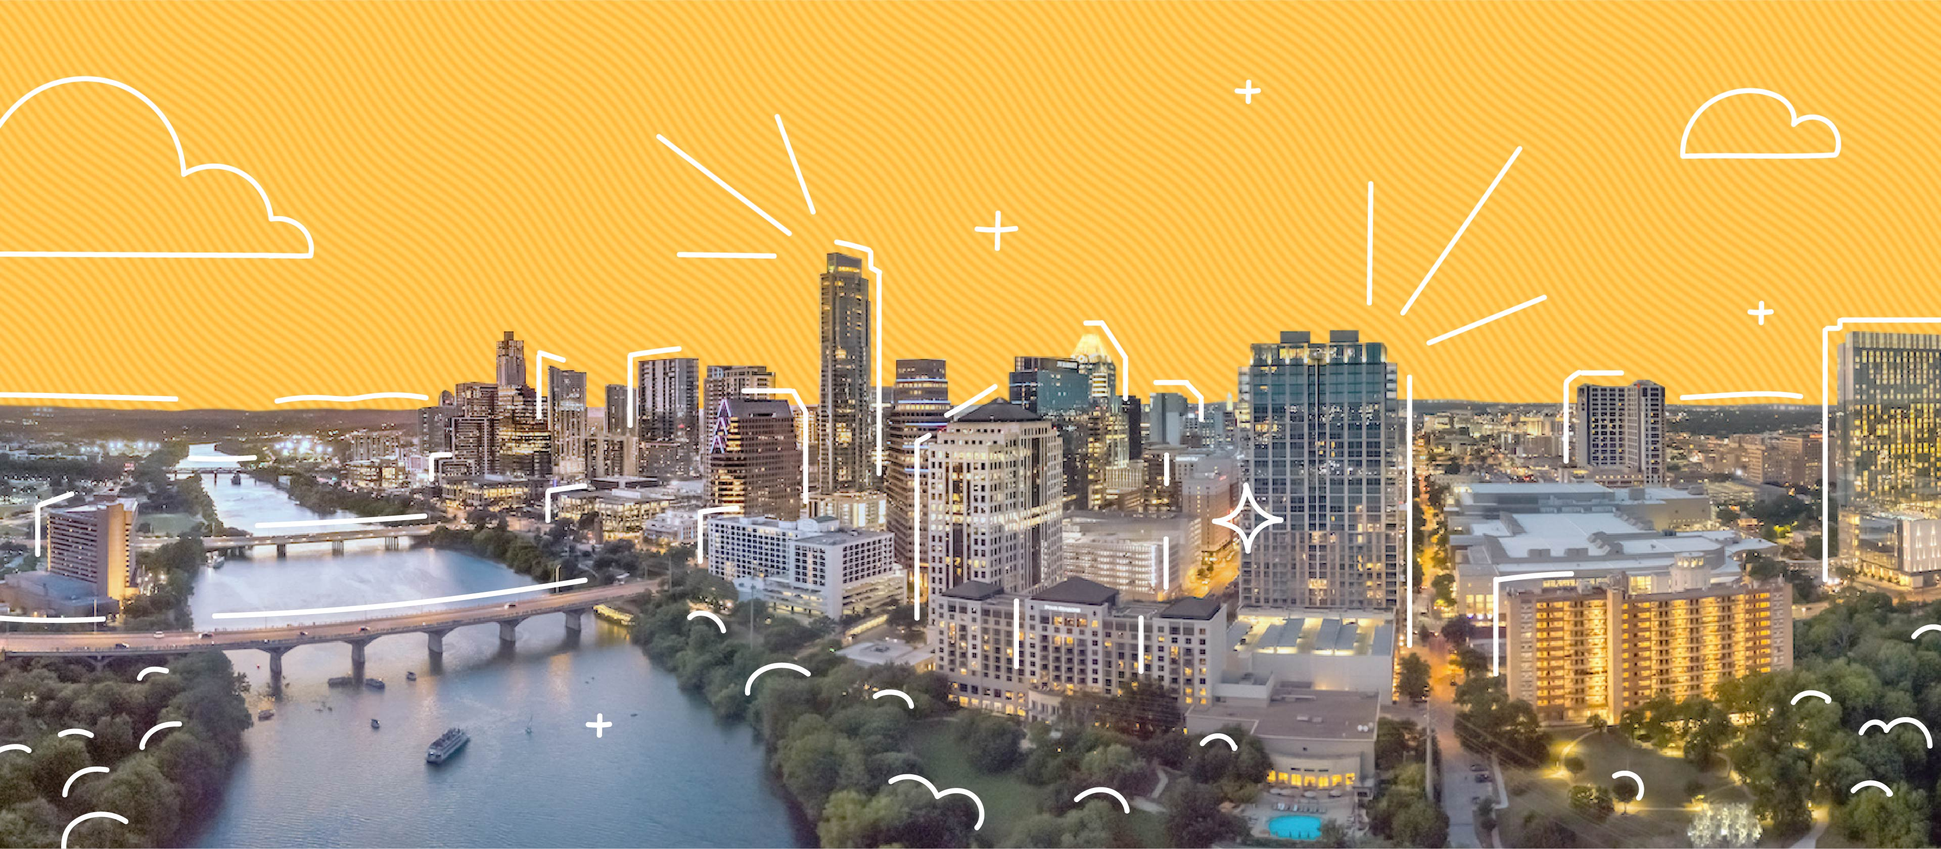
COS 214 Project
sudo-apt-get-marks

Slide 2
sudo-apt-get-marks members
u22497082 - Ethan Vletter
u22652974 - Carinda Smith
u23632730 - Janri du Toit
u23577674 - Ethan Wilke
u23656175 - James Neale
u23708833 - Megan Pretorius
u23590883 - Marco Paximadis

Slide 3
Introduction

Slide 4
Final class diagram

Slide 5

City Management:
Create and manage different types of buildings.
The Building class implements the Strategy design pattern, enabling a flexible and dynamic approach to creating building types. We use four primary groups of buildings, namely Residential, Institutional, Commercial, and Industrial. Each group contains three subtypes of buildings.
Each subtype has its own unique factors, for example, resource allocation, calculation of square footage, the number of rooms created, and many more. This differentiation ensures that the build function for each type of building is tailored to its specific requirements.
We also implemented the Prototype design pattern, enabling us to create new instances of buildings by cloning existing ones.
Furthermore, we have integration between buildings and citizens. Each building can be associated with a specific type of citizen, creating a relationship between where people live and work. For example, a Commercial Worker can be linked to a House to indicate their residence and can also be connected to either a Mall, Shop, or Office, which signify their workplace. This integration provides a comprehensive view of community dynamics, highlighting both residential and workplace (Institutional, Commercial, and Industrial) interactions.

Slide 6
Buildings
Add class diagram

Slide 7
Buildings
Relationships that were created between Buildings and Citizens:
CommercialWorker: Workplace: shop/mall/office Residence: House
GovernmentWorker: Workplace: school/hospital/government Residence: Mansion
IndustrialWorker: Workplace: warehouse/plant/factory Residence: Apartment
Participants:
Context: Building
Strategy: Residential, Instatutional, Commercial, Industrial
ConcreteStrategy: Shop, Mall, Office,Warehouse, Factory, Plant,House, Apartment, Mansion, Hospital, School, Government
algorithm(): build()

Slide 8

City Management:
Manage Utilities
Powerplants : generate electricity to supply to city.
Functional and Non-functional
Water Supply : ensure steady distribution of water.
Functional and Non-functional
Waste Management : handle waste removal and recycling.
Functional and Non-functional

Slide 9
Utilities
Add class diagram

Slide 10
Utilities
Explain pattern , attributes and methods

Slide 11
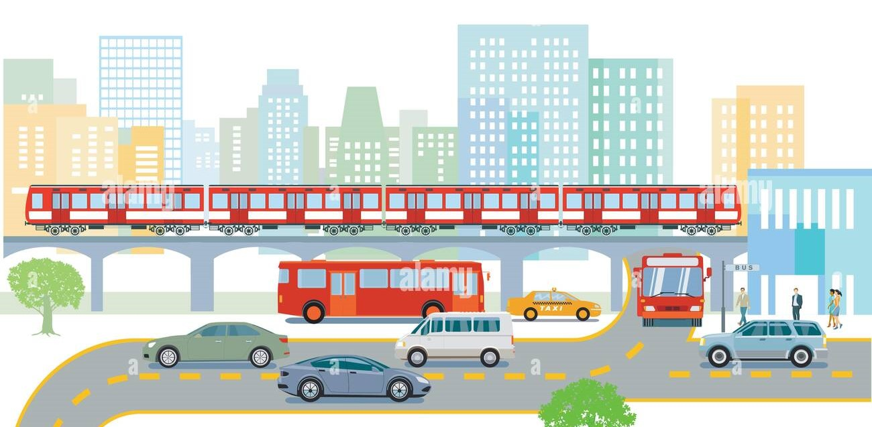
City Management:
Handle Transportation system.
Roads: Basic infrastructure for public transport movement.
Public Transit: Buses to transport citizens to and from place of employment.
Commercial busses transport Commercial Workers to/from
Residence: House to/from Workplace: shop/mall/office on a Commercial road
Government busses transport Government Workers to/from Residence: Mansion to/from Workplace: school/hospital/government on a Government road
Industrial busses transport Industrial Workers to/from Residence: Apartment to/from Workplace: warehouse/plant/factory on an Industrial road
Trains: Transport materials on railways

Slide 12
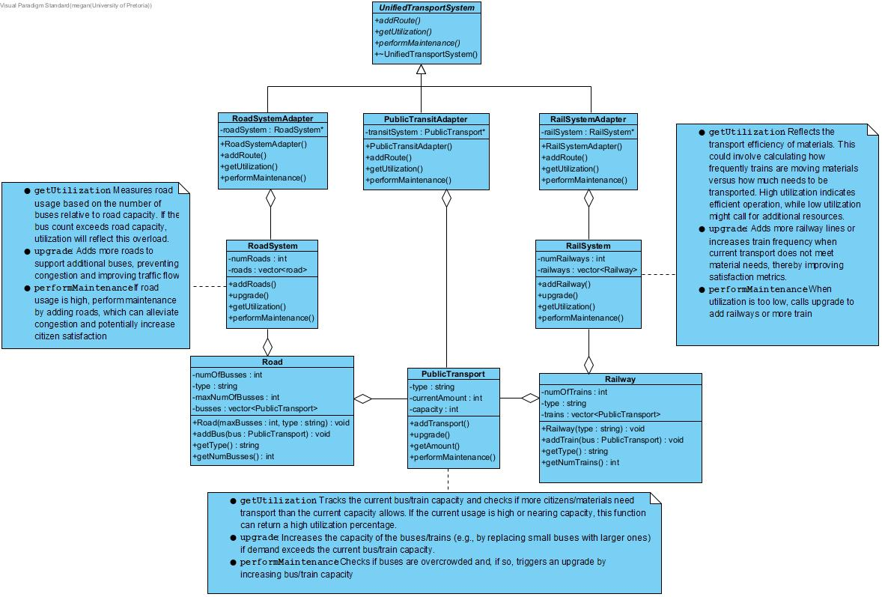
Transportation

Slide 13
Transportation
Explain pattern and attributes and methods

Slide 14
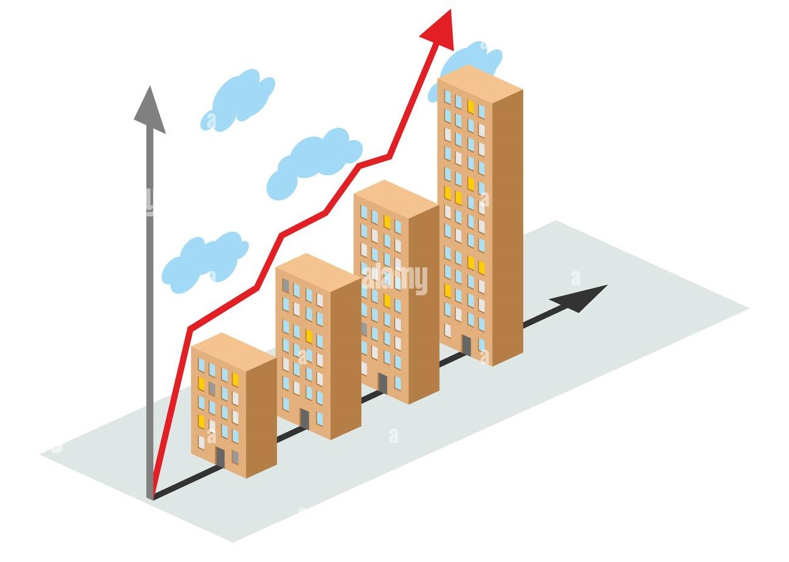
City Management:
City creation and growth

Slide 15
City Management:
Add class diagram

Slide 16
City Management:
Explain pattern , attributes and methods

Slide 17

Resources:
Explain resources

Slide 18
Resources:
Add class diagram

Slide 19
Resources:
Explain pattern , attributes and methods

Slide 20

Taxes
Explain taxes

Slide 21
Taxes
Add class diagram

Slide 22
Taxes
Explain pattern , attributes and methods

Slide 23
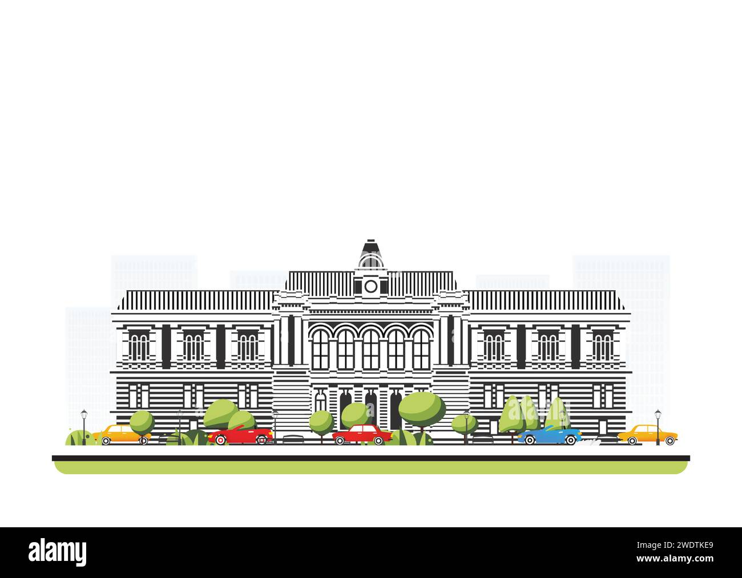
Government
Explain government

Slide 24
Government
Add class diagram

Slide 25
Government
Explain pattern , attributes and methods

